Slide 1


DATASTRUCTURE
DATRUCTURE IS THE WAY OF ORGANIZING ALL DATA ITEMS IN ORDER THAT NOT ONLY ELEMENTS TO BE STORED BUT ALSO THE RELATION BETWEEN THE ELEMENTS

Slide 2

INTRODUCTION
Data structure:-A data structure is a logical representation of data and operation that can be performed on the data.
linear data structure 2)Non linear data structure
Linear data structure is an order of data elements. They are arrays, stacks, queues, and linked lists.

Slide 3
Linked list :- linked list is a linear data structure. It contains nodes. Each node contains two parts, i.e. DATA part and LINK part.
The data contains elements and
Link contains address of another node.

Slide 4
LIMITATIONS OF ARRAYS
Arrays are simple to understand and elements of an array are easily accessible
But arrays have some limitations.
Arrays have a fixed dimension.
Once the size of an array is decided it can not be increased or decreased during education.

Slide 5
Array elements are always stored in contiguous memory locations.
Operations like insertion or deletion of the array are pretty tedious.
To over come this limitations we use linked list.

Slide 6

LINKED LISTS
Linked list is a collection of elements called nodes.
Each node contains two parts. they are data part and link part.
Node
data
link

Slide 7
14
100
30
400
42
N
200
100
400
The above figure shows the example of marks obtained by different students can be stored in a linked list
Here N-stands for NULL.
Null indicates the end of the node.

Slide 8
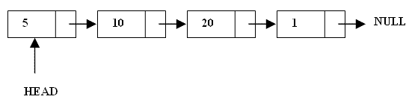
WHAT ARE LINKED LISTS
 A linked list is a linear data structure.
 Nodes make up linked lists.
 Nodes are structures made up of data and a pointer to another node.
 Usually the pointer is called next.

Slide 9
What is Linked List?
A linked list is a collection of nodes with various fields It contains data field and Address field or Link field
Pointer to the first node
Info field
Link Field/ Address Field

Slide 10
ARRAYS VS LINKED LISTS
Arrays | Linked list
Fixed size: Resizing is expensive | Dynamic size
Insertions and Deletions are inefficient: Elements are usually shifted | Insertions and Deletions are efficient: No shifting
Random access i.e., efficient indexing | No random access → Not suitable for operations requiring accessing elements by index such as sorting
No memory waste if the array is full or almost full; otherwise may result in much memory waste. | Since memory is allocated dynamically(acc. to our need) there is no waste of memory.
Sequential access is faster [Reason: Elements in contiguous memory locations] | Sequential access is slow [Reason: Elements not in contiguous memory locations]

Slide 11

TYPES OF LINKED LISTS
Single linked list
Double linked list
Circular linked list
Circular double linked list

Slide 12
SINGLE LINKED LIST :-
A single linked list is one in which all nodes are linked together in some sequential manner.
CIRCULAR LINKED LIST :-
A circular linked list is one which has no beginning and no ending. The null pointer in the last node of a linked list is replaced with the address of its first node such a list is called circular linked list.

Slide 13
Graphical Representation
Singly Linked List
First
10
1000
15
2000
20
NULL
4000
1000
2000

Slide 14
Graphical Representation
Circular Singly Linked List
First
Last node contains the address of the first node
10
1000
15
2000
20
4000
4000
1000
2000

Slide 15
SINGLE LINKED LIST :
500
45 100
60
200
35
N
Start
CIRCULAR LINKED LIST:-
45 100
400
60 200
100
35
400
200

Slide 16

Inserting a new node : Before inserting:
14 100
35 200
20
N
400
After inserting:
100
200
14 100
400
35
200
20
N
75 400
100
200
800

Slide 17
Delete a node from the list: before deletion:
35 400
48
300
46 500
300
30
N
200 400
after deletion :
500
35 400
200
46 500
300
30
N
500

Slide 18
In circular linked list we have three functions. They are
addcirq( )
delcirq( )
cirq_display( )

Slide 19
addcirq( ) :-
This parameters.
function accepts three
First parameter receives the address of the first node.
The second parameter receives the address of the pointer to the last node.

Slide 20
Delcirq( ) :-
This function receives two parameters.
The first parameter is the pointer to the front node.
The second is the pointer to the rear.
front
rear
10
17
16
5

Slide 21

.DOUBLE LINKED LIST :-
A single linked list disadvantages
has some
That it can traverse it in one direction.
Many applications require backword and forword sections of a list
searching travelling

Slide 22
A two way list is a linear collection of data elements called nodes.
When each node is divided into three parts. They are two link parts and one data part.
node
prev | data | next

Slide 23
Doubly Linked list
Contains the address of previous node and next node
First
NULL
10
2000
1000 | 15 | 3000
2000 | 20 N | ULL
1000
2000
3000

Slide 24
Inserting a new node : Before insertion:-
N | 11 | 100
200 | 20 | 400
100 | 40 | N
200
After insertion:-
100
400
100 | 40 | N
N | 11 | 100
200
20
400
400
25
100

Slide 25
Delete a node from the list: Before deletion:-
N | 5 | 200
600 | 11 | 400
200 | 4 | N
600
200
400
After deletion:-
N | 11 | 400
200 | 4 | N
200
400

Slide 26

Circular Doubly Linked list
Contains the address of first node and last node
First
 | 3000 | 10 | 2000
1000
1000 | 15 | 3000
2000
20 1
000
2000
3000

Slide 27
REVERSING THE LINKS :
Reversing means the last node becomes the first node and the first becomes the last.
5 23 3 17 N
5
23
3
17
17
3
23
5
N

Slide 28
MERGING OF LINKED LIST :
suppose we have two linked lists.
That are pointed to two independent pointers. We have to merge the two links into a third list.
By using this merge ( ) to ensure that those elements which are common to both the lists occur only once in the third list.

Slide 29
9
1
14
2
N
12
1
24
7
N
9
12
1
1
24
4
7
N

Slide 30
SORTING OF A LINKED LIST :
Sorting means to arrange the elements either in ascending or descending order.
To sort the elements of a linked list we use any of the standard sorting algorithms for carrying out the sorting.
While performing the sorting, when it is time to exchange two elements, we can adopt any of the following two strategies.

Slide 31
1)Exchange the data part of the two nodes, keeping the links intact.
2
8
4
3
N
2
3
4
8
N

Slide 32
2) Keep the data in the nodes intact.
Simply readjust effectively the changes
the order
links such that of the nodes
11 N
2
400
8 500
4
600
200
400
0
60
0
50
4
40
0
11
N
2
50
0
8
60
0
200
400
500
600

Slide 33
RECURSIVE OPERATIONS ON LINKED LIST :
A function called by itself known as recursion.
If a statement within the body of a function calls the same function.
Some of the operations that are carried out on linked list can be easily implemented using recursion.

Slide 34
For example finding out the number of nodes present in a linked list, comparing two lists, copying one linked list into another, adding a new node at the end of the linked list, etc.,

Slide 35
OPERATIONS ON LINKED LISTS
The basic operations on linked lists are
Creation
Insertion
Deletion
Traversing
Searching
Concatenation
Display

Slide 36
The creation operation is used to create a linked list.
Insertion operation is used to insert a new node in the linked list at the specified position. A new node may be inserted at the beginning of a linked list , at the end of the linked list , at the specified position in a linked list. If the list itself is empty , then the new node is inserted as a first node.

Slide 37
Deletion operation is used to delete on item from the linked list. It may be deleted from the beginning of a linked list , specified position in the list.
Traversing operation is a process of going through all the nodes of a linked list from one end to the another end. If we start traversing from the very first node towards the last node , It is called forward traversing.

Slide 38
If the traversal start from the last node towards the first node , it is called back word traversing.
Searching operation is a process of accessing the desired node in the list. We start searching node –by-node and compare the data of the node with the key.

Slide 39
Concatenation operation is the process of appending the second list to the end of the first list. When we concatenate two lists , the resultant list becomes larger in size.
The display operation is used to print each and every node’s information.

Slide 40
BASIC OPERATIONS ON A LIST
Creating a List
Inserting an element in a list
Deleting an element from a list
Searching a list
Reversing a list

Slide 41
INSERTION AT THE BEGINNING
There are two steps to be followed:-
Make the next pointer of the node point towards the first node of the list
Make the start pointer point towards this new node
If the list is empty simply make the start pointer point towards the new node;

Slide 42
INSERTING THE NODE IN A SLL
There are 3 cases here:-
Insertion at the beginning
Insertion at the end
Insertion after a particular node

Slide 43
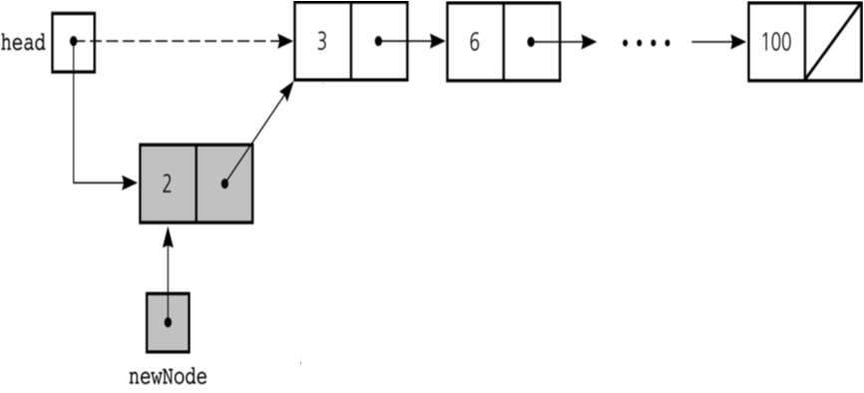

Slide 44

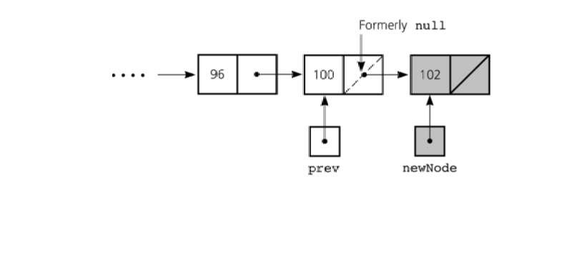
INSERTING AT THE END
Here we simply need to make the next pointer
of the last node point to the new node

Slide 45
INSERTING AFTER AN ELEMENT
Here we again need to do 2 steps :-
Make the next pointer of the node to be inserted point to the next node of the node after which you want to insert the node
Make the next pointer of the node after which the node is to be inserted, point to the node to be inserted

Slide 46
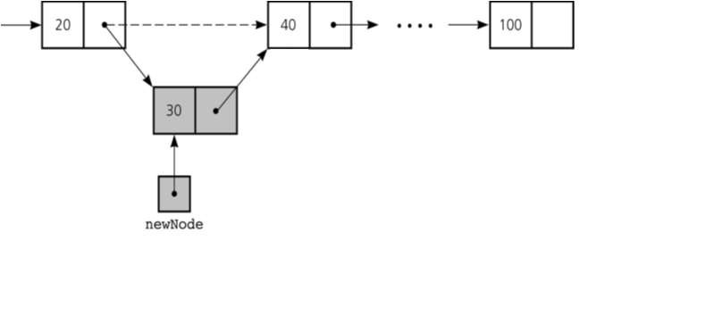

Slide 47
DELETING A NODE IN SLL
Here also we have three cases:-
Deleting the first node
Deleting the last node
Deleting the intermediate node

Slide 48



DELETING THE FIRST NODE
Here we apply 2 steps:-
Making the start pointer point towards the 2nd node
Deleting the first node using delete keyword
start
one
two
three

Slide 49


DELETING THE LAST NODE
Here we apply 2 steps:-
Making the second last node’s next pointer point to NULL
Deleting the last node via delete keyword
start
node1 node2 node3

Slide 50
DELETING A PARTICULAR NODE
Here we make the next pointer of the node previous to the node being deleted ,point to the successor node of the node to be deleted and then delete the node using delete keyword
node1 node2
node3
To be deleted

Slide 51

SEARCHING
 Searching involves finding the required element in the list
 We can use various techniques of searching like linear search or binary search where binary search is more efficient in case of Arrays
 But in case of linked list since random access is not available it would become complex to do binary search in it
 We can perform simple linear search traversal
 In linear search each node is traversed till the data in the node matches with the required value

Slide 52
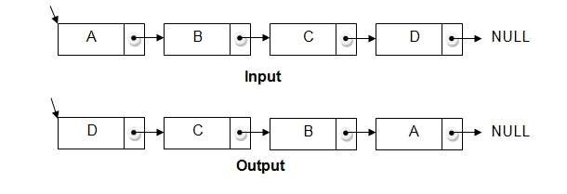
REVERSING A LINKED LIST
We can reverse a linked list by reversing the direction of the links between 2 nodes

Slide 53
COMPLEXITY OF VARIOUS
OPERATIONS IN ARRAYS AND SLL
Operation | ID-Array Complexity | Singly-linked list Complexity
Insert at beginning | O(n) | O(1)
Insert at end | O(1) | O(1) if the list has tail reference O(n) if the list has no tail reference
Insert at middle | O(n) | O(n)
Delete at beginning | O(n) | O(1)
Delete at end | O(1) | O(n)
Delete at middle | O(n): O(1) access followed by O(n) shift | O(n): O(n) search, followed by O(1) delete
Search | O(n) linear search O(log n) Binary search | O(n)
Indexing: What is the element at a given position k? | O(1) | O(n)

Slide 54

DOUBLY LINKED LIST
1. Doubly linked list is a linked data structure that consists of a set of sequentially linked records called nodes.
2 .
Each node contains three fields ::
-: one is data part which contain data only.
-:two other field is links part that are point or references to the previous or to the next node in the sequence of nodes.
3.
The beginning and ending nodes' previous and next links, respectively, point to some kind of terminator, typically a sentinel node or null to facilitate traversal of the list.

Slide 55
NODE
previous | data | next
A
B
NULL | 11 | 786
200
656
400
786 | 777 | NULL
C
200
786
400
A doubly linked list contain three fields: an integer value, the link to the next node, and the link to the

Slide 56
DLL’S COMPARED TO SLL’S
Advantages:
Can be traversed in either direction (may be essential for some programs)
Some operations, such as deletion and inserting before a node, become easier
Disadvantages:
Requires more space
List manipulations are slower (because more links must be changed)
Greater chance of having bugs (because more links must be manipulated)

Slide 57

STRUCTURE OF DLL
previous. inf
.Data
.next

Slide 58


INSERTING AT BEGINNING

Slide 59
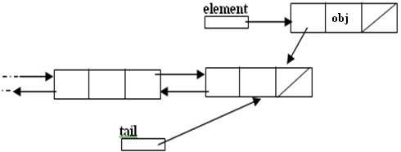
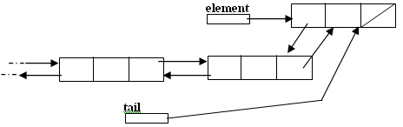
INSERTING AT THE END

Slide 60
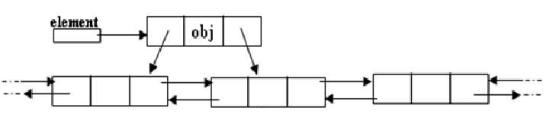
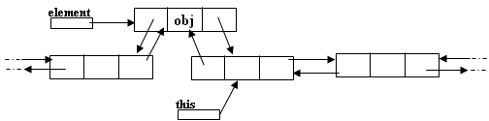
INSERTING AFTER A NODE
Making next and previous pointer of the node to be inserted point accordingly
Adjusting the next and previous pointers of the nodes b/w which the new node accordingly

Slide 61



DELETING A NODE
Node deletion from a DLL involves changing two links
In this example,we will delete node b
myDLL
a b
c
We don’t have to do anything about the links in node
b
Garbage collection will take care of deleted nodes
Deletion of the first node or the last node is a special case

Slide 62
ADVANTAGES OF LINKED LISTS
We can dynamically allocate memory space as needed
We can release the unused space in the situation where the allocated space seems to be more.
Operation related to data elements like insertions or deletion are more simplified.

Slide 63
Operation like insertion or deletion are less time consuming.
Linked lists provide flexibility in allowing the items to be arranged efficiently.

